Slide 1


Cinderella Rockerfella
Thank you for a wonderful performance.

Slide 2
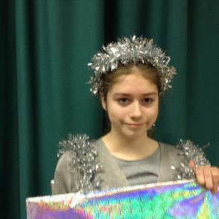
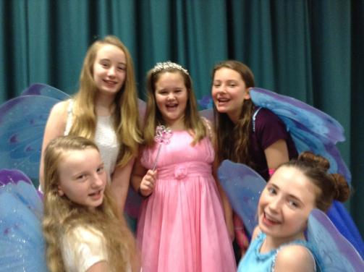
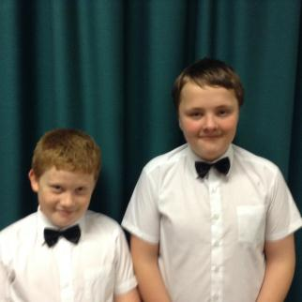
Wow! What a performance! Well done to all involved – there has been a lot of effort put in and I really enjoyed it.
Wonderful, so great to see so many children and families here!
Amazing effort! The kids obviously loved doing it and the little girl at the end – her singing gave me shivers xx

Slide 3

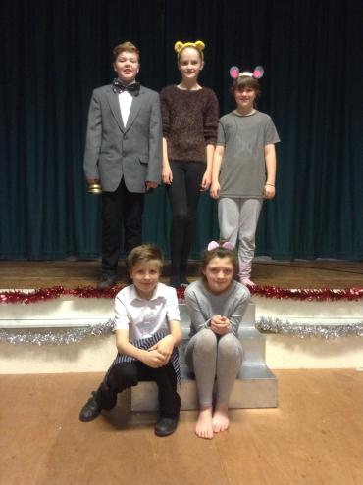
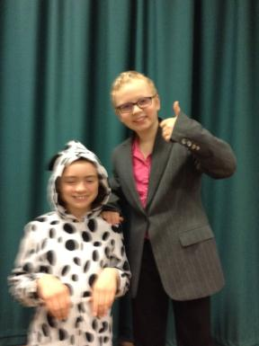
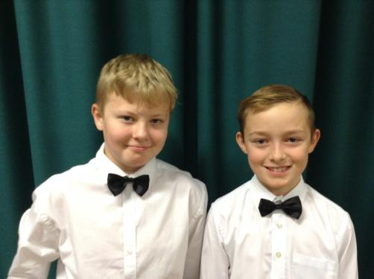
WOW!
Well done Mrs Samuels and all the children ☺ xxx
Very good. I really enjoyed the singing – especially when all the cast were together. Very very good all round
Great singing!
Well done everyone!

Slide 4
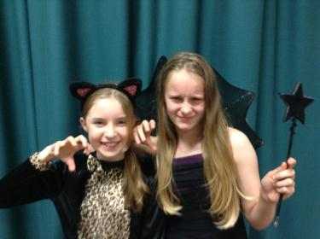
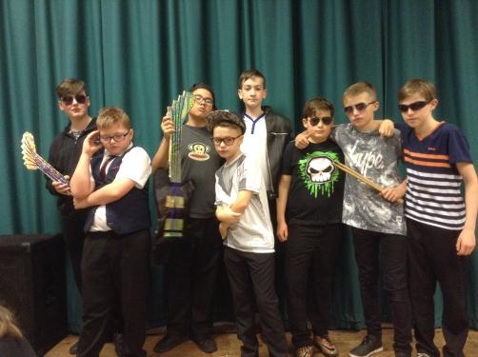
Absolutely fabulous Well done to everyone, children and staff alike.
Very professional – looking forward to next year already!!
Absolutely fantastic. I couldn’t believe the talent that was here tonight!
Much appreciation to Mrs Samuels and the crew behind it all. We need to see more things like this!!! Thank you.

Slide 5
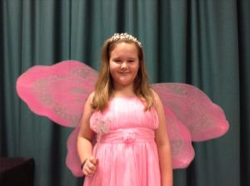
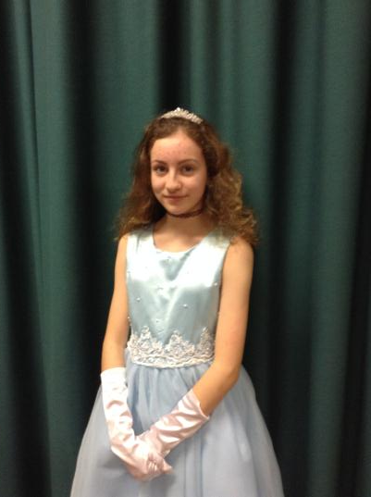
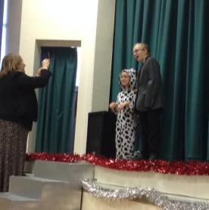
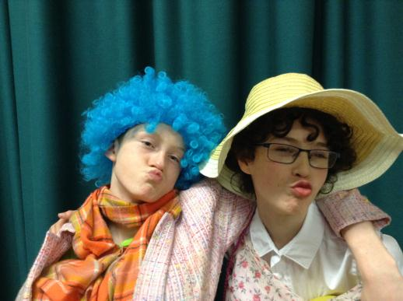
Brilliant
Laughed so much it hurts
Good job all.
Superb performance – especially the ugly sisters!
Excellent production. The children looked like they were having fun and were filled with confidence!

Slide 6
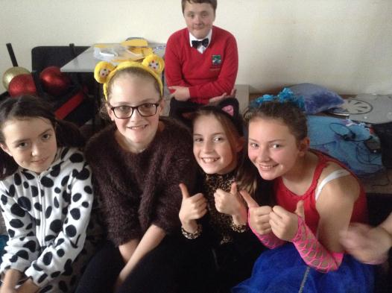
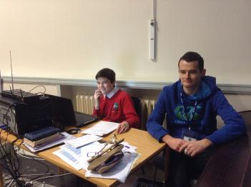
Very professional – worth coming from Stocksfield to watch it. Very well done everyone.
The children were fantastic – had a great time.
Brill
Can’t wait for the next one. Keep up the good work kids.
Absolutely brilliant, full of laughter. Great singing, the ugly sisters were fab! Great confidence shown by all.

Slide 7
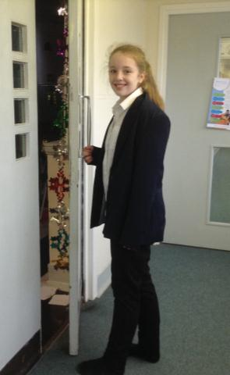
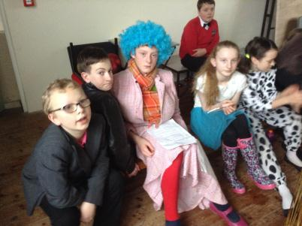
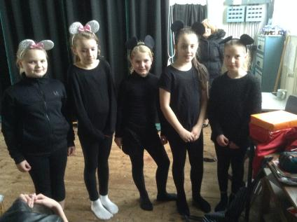
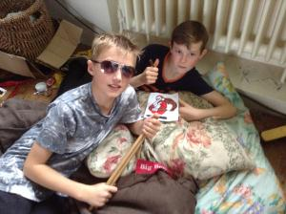
Excellent performance, loved every minute. Very talented children.
Top class performance – really enjoyed it. The singing was fantastic.
Fantastic evening. Well done to all involved. Really enjoyable.

Slide 8
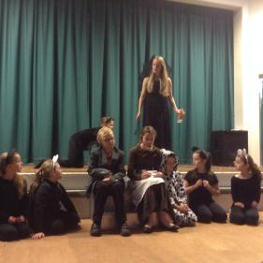
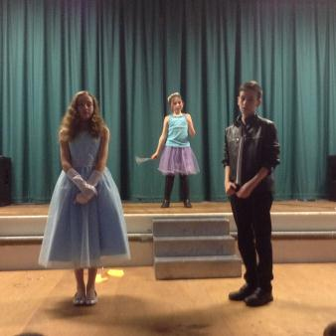
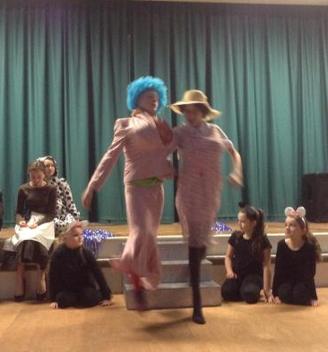
Best ever production. Fantastic singing and acting and such fun. Thank you.
Lovely to see such enthusiasm from the cast and they are a credit to the school.
Fab school play. Audience participation good. Singing excellent. Costumes impressive. Microphone head sets really helpful.
Great job! Lovely to see everyone working together to make such a fab production. A great confidence builder for my son.

Slide 9
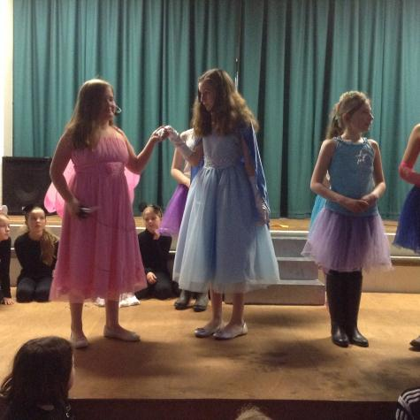
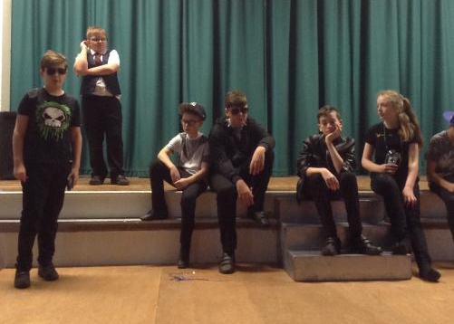
The last performance I saw was nearly 10 years ago but this blew it out of the water! FANTASTIC!! Would love to see more performances.
You could tell that everyone enjoyed themselves!

Slide 10
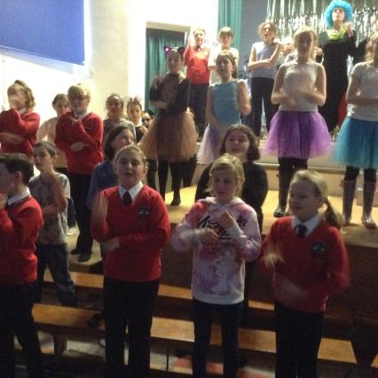
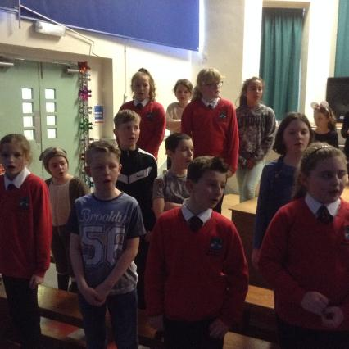
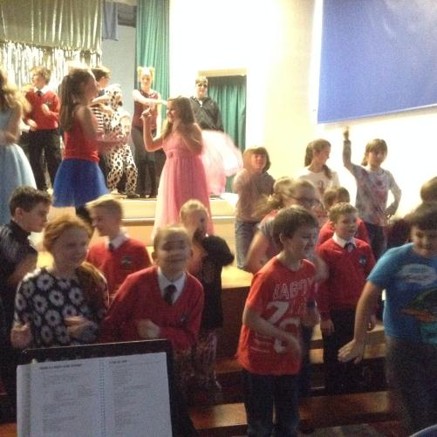
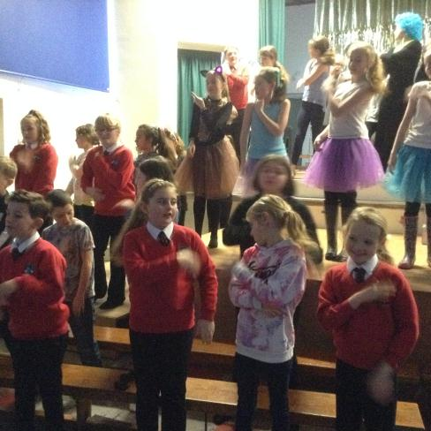

Slide 11
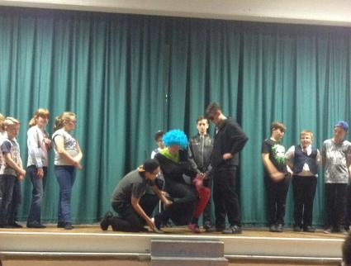
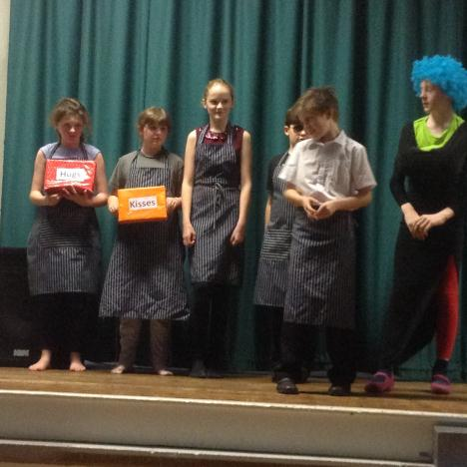
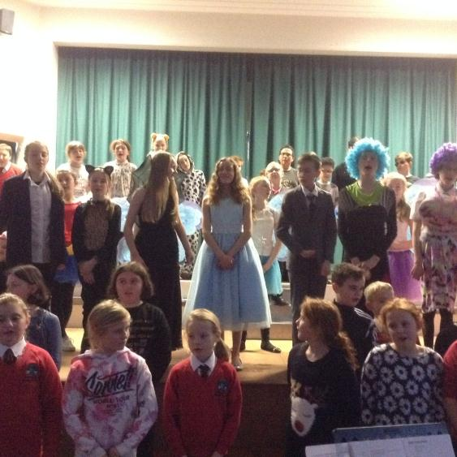

Slide 12
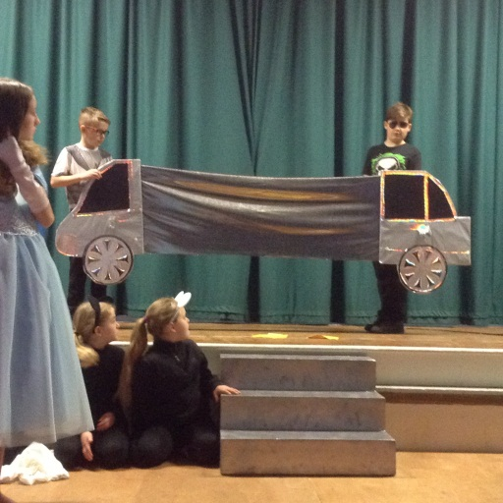
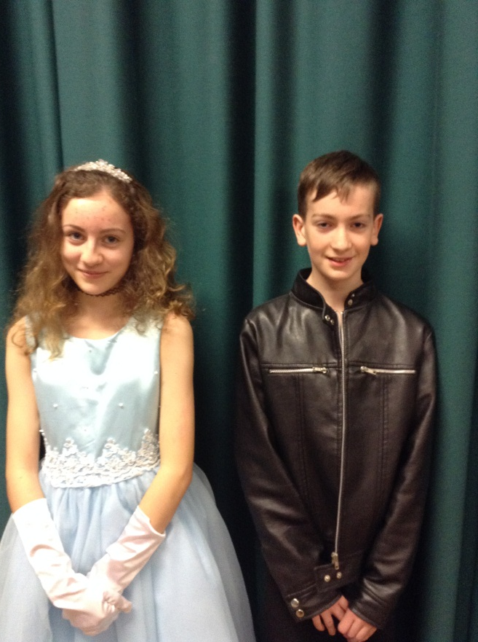
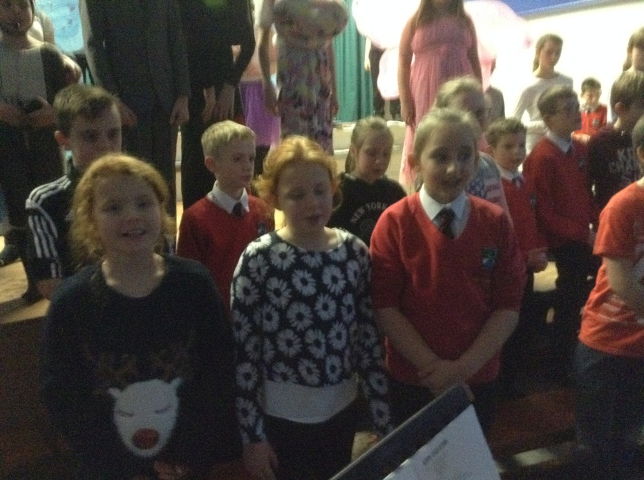

Slide 13
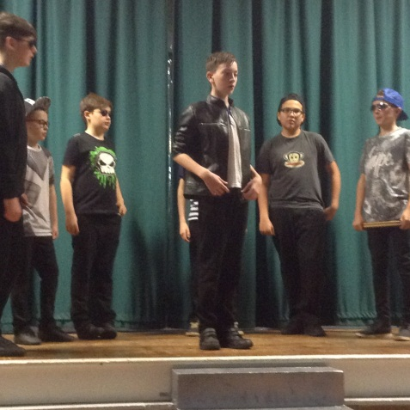
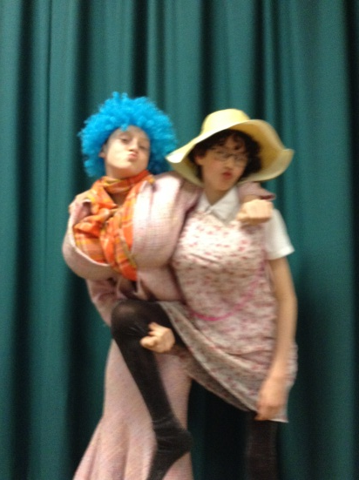
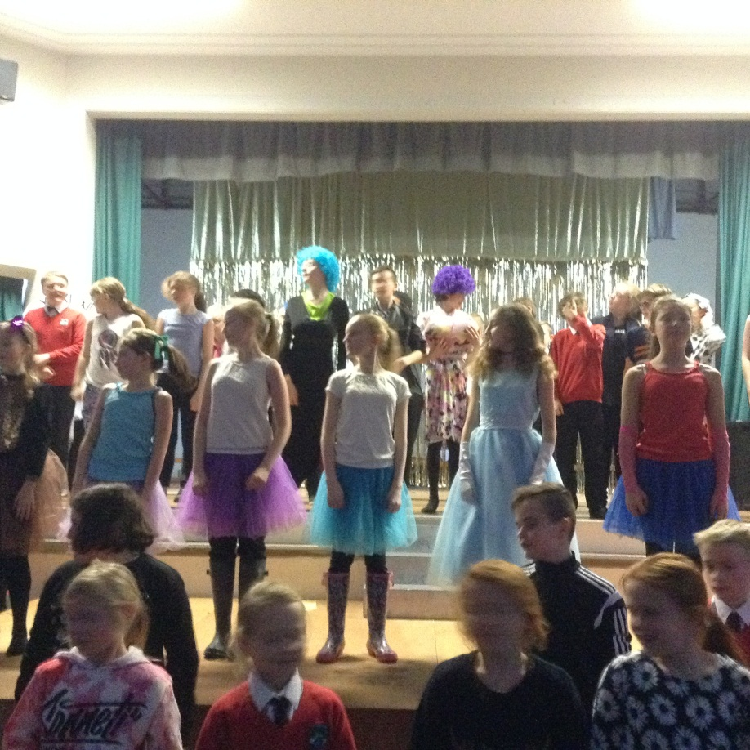
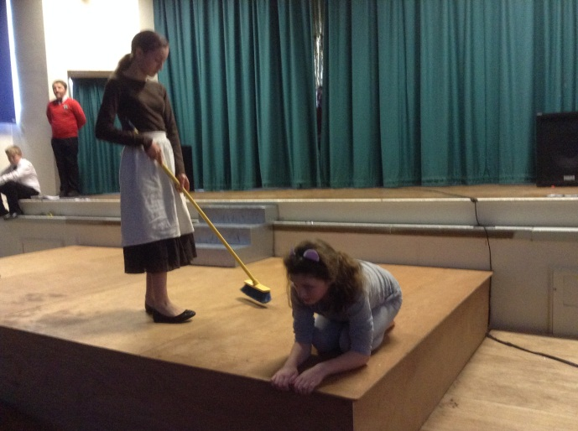

Slide 14
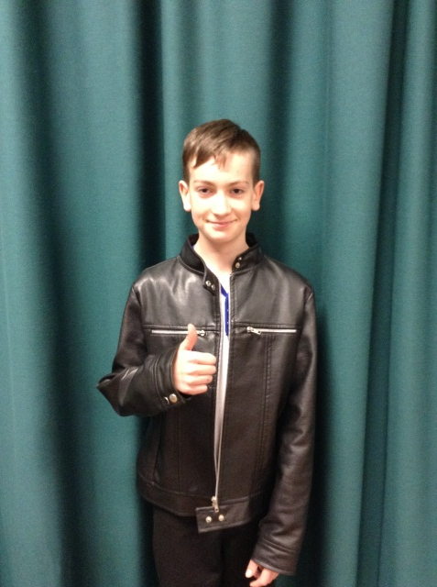
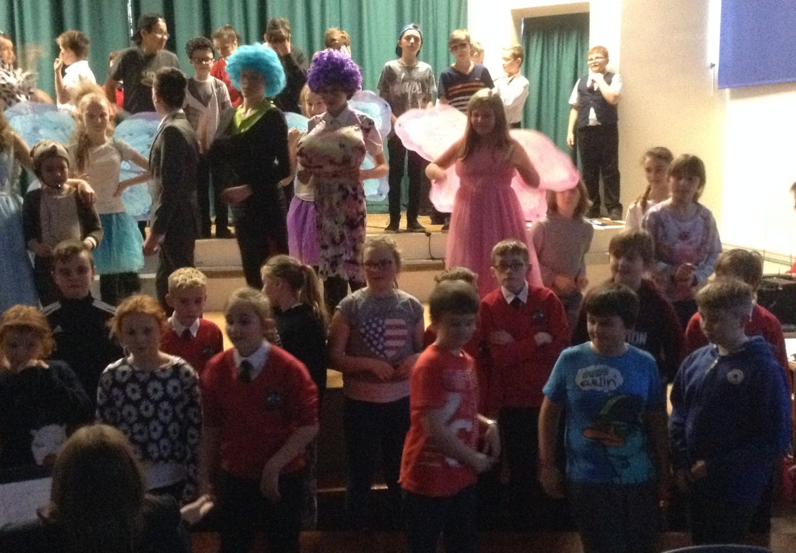
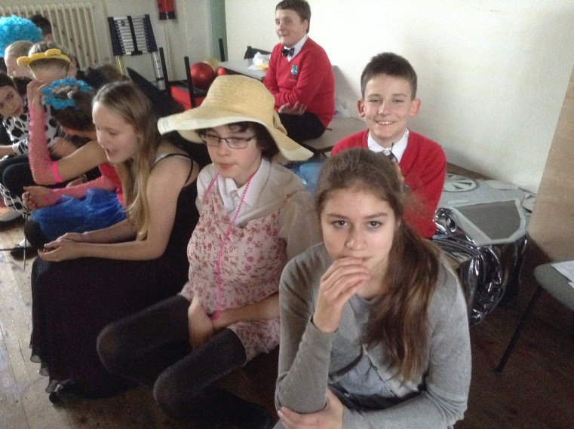

Slide 15

Thank you to Mrs Samuels who did such an amazing job – you put such passion and enthusiasm into this project we were all inspired and

Slide 16
Thank you to all the staff who helped make this possible because this would not have happened without your support and

Slide 17
Thank you to all the parents and families who joined us on the night and gave us such wonderful feedback and

Slide 18


Thank you to all the children who took part and were beautiful shining stars.

Slide 19
May you all have a Merry Christmas and

Slide 20
Live Happily Ever After

