Slide 1
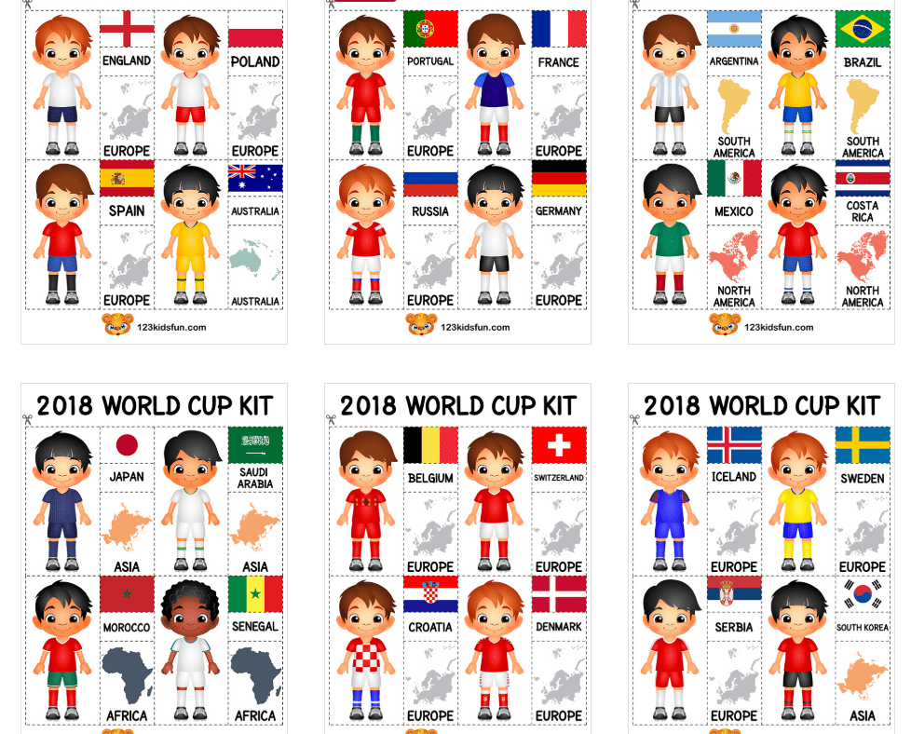
Enrichment Homework
Autumn 2
Subject: PSHE
Link to learning:
Together as a school we are going to be celebrating all things FOOTBALL for the FIFA world cup 2022! You will be given a choice of many world cup related activities for your enrichment homework.
Task:
Linking to our topic celebrating differences, research the culture of your given country and present it via a visual mood board. Try including: food, clothing, religion and traditions.
Expectations:
Chose the country that you want to research
Research information about their culture;-
Their Food
Clothing
Religion
Traditions
Anything ells interesting you found out
3. Present your research on a mood board with titles and information explaining your findings. Be creative, your work will be displayed in school.
Due date:
Monday 19th December 2022

