Slide 1
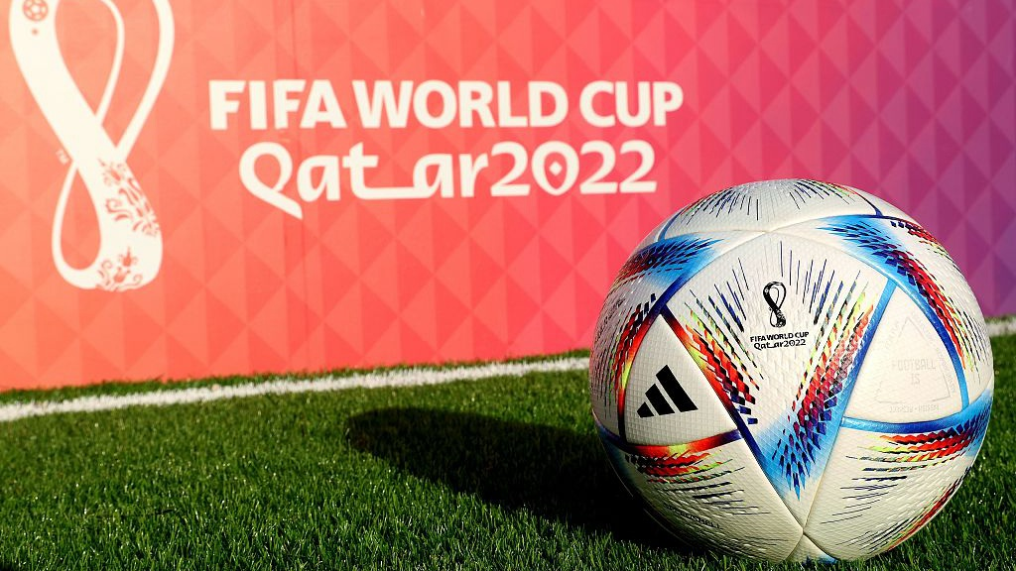
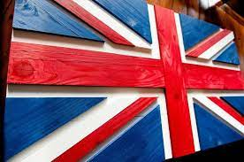
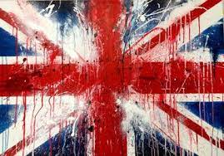
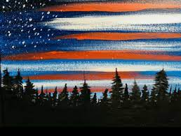
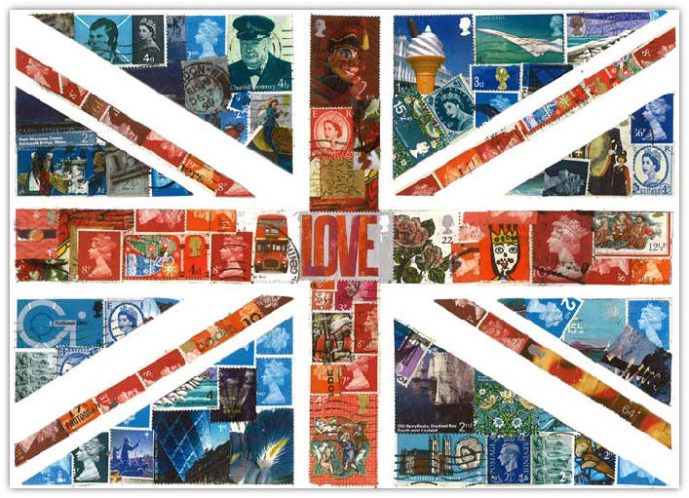
Enrichment Homework
Autumn 2
Year Group: 5
Subject: Art
Link to learning:
Together as a school we are going to be celebrating all things FOOTBALL for the FIFA world cup 2022! You will be given a choice of many world cup related activities for your enrichment homework.
My Task
I would like you to create a flag of your chosen football team in a unique way. Don’t just draw and colour a flag, how can you make yours special and unique?
Expectations:
Research what your chosen flag looks like
Look at some interesting art ideas for creating your flag.
Make your flag in at least an A4 normal paper size
You can use collage, paint, pens, sculpture, woodwork or any other medium you like.
Write your name on the design and hand it in to Mrs McGregor with your enrichment bool. DO NOT STICK IT IN THE BOOK, ALL THE ARTWORK WILL GO ON DISPLAY.
Due date:
Wednesday 14th of December 2022

