Slide 1
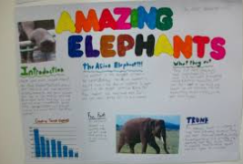
Enrichment Homework
Autumn 2
Subject: KS2 P.E
Link to learning:
Together as a school we are going to be celebrating all things FOOTBALL for the FIFA world cup 2022! You will be given a choice of many world cup related activities for your enrichment homework.
Task: Research a famous footballer from your given country. You could include the following information: their personal achievements, their childhood, their career, information about the team/teams they play for and their history.
Expectations:
-You will need to complete extensive research.
-Present as a non-chronological report.
-Include subheadings.
-You may want to include images.
-Take care to write in a formal style using the correct grammar, spelling and punctuation.
-This can be created digitally or hand-written.
Due date:
Monday 19th December 2022

